Slide 1

#PHASE - I - REVIEW - 1
</HUNGER>
An initiative project to end the starvation.

Slide 2
DSN3099 - Engineering Projects in Community Service
Group Members:
19BAI10008 PRANJAL ROY
19BAI10017 SHANZEH BATOOL
19BAI10081 VAIBHAV ROY
19BAI10095 KARAN JAIN
19BAI10139 SHALINI DAS
19BCE10108 ASHI SACHAN
19BCY10044 KRISHNA KUMAR AGRAWAL
19BEE10020 RITUPARNA GUPTA

Slide 3
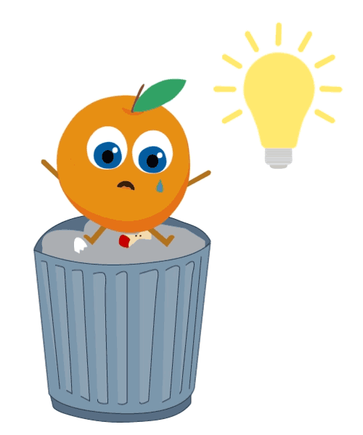
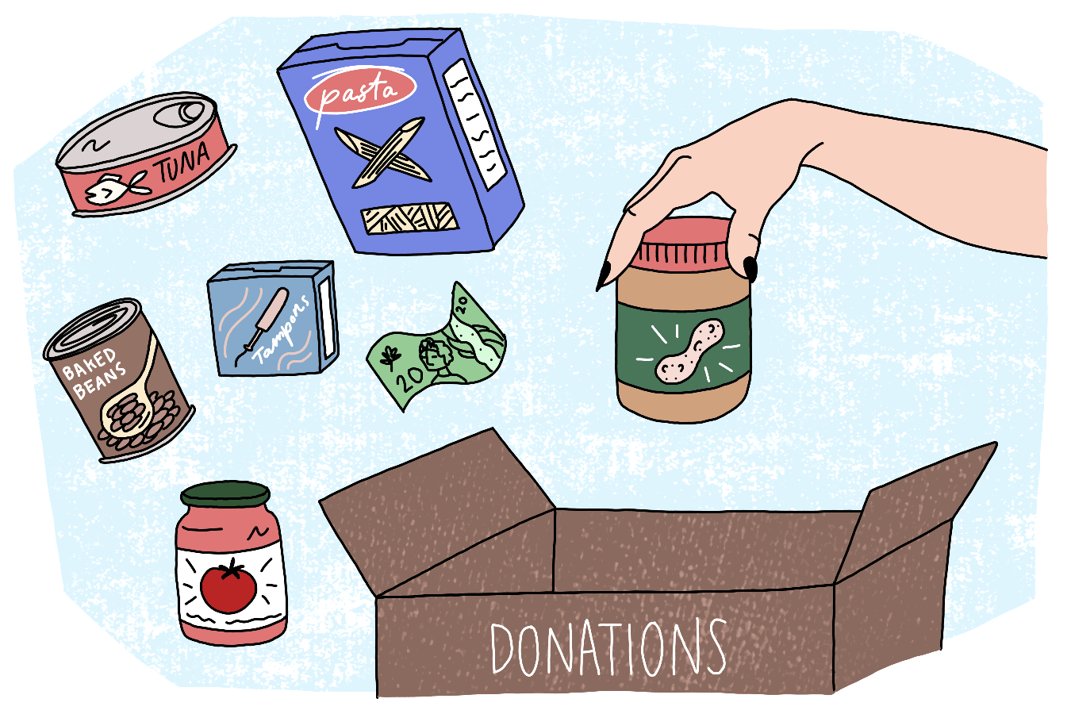


Introduction:
On an average 40% food produced in restaurants, cafes, hotels and marriages is wasted in form of garbage disposal or is just thrown in empty plots/ gutters/ dustbins etc.
Over 20 crore Indians go to sleep empty-stomach every day. FAO 2019 Report reveals that around 14.5% of the Indian population falls beneath the underfed category.
So observing these facts we have planned to come up with an effective solution to minimize the starvation of food in India.

Slide 4
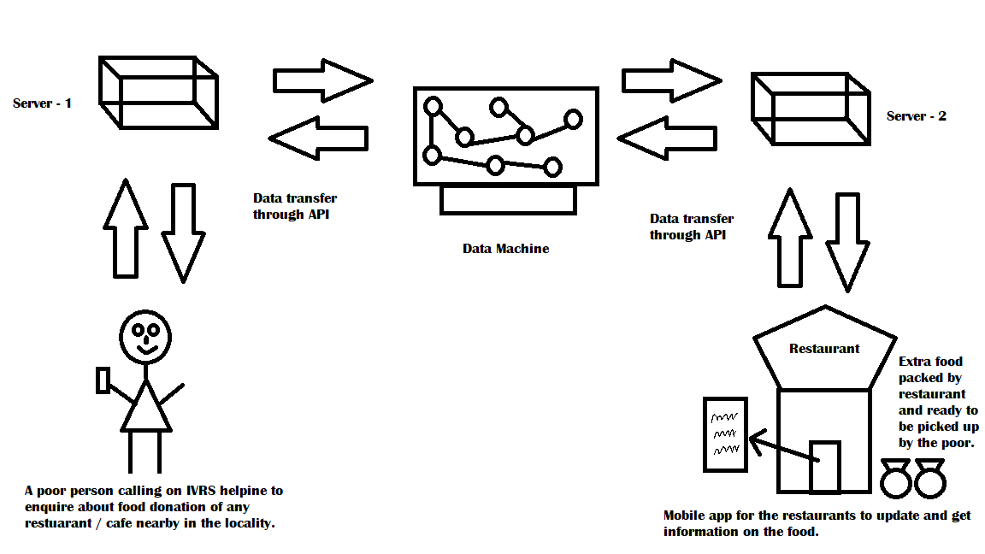
System Design:
Notes:
Thanks ma

Slide 5
Language Processing
SPEECH TO TEXT
TRANSLATE THE TEXT LANGUAGE TO ENGLISH LANGUAGE
INFORMATION EXTRACTION
TEXT TO SPEECH
TRANSLATE THE ENGLISH TEXT LANGUAGE TO ORIGINAL LANGUAGE
ALGORITHM

Slide 6
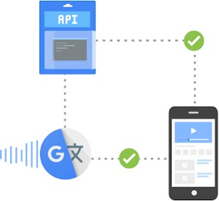
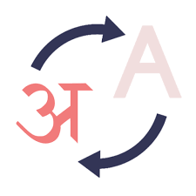
Translation
Translation aims at conveying meanings of given linguistic discourse.
Translation Studies entails systematic translation and ensures clear and efficient communication between languages and culture.
For translation, we will use Google Translate which will ensure auto language detection, bulk translations and is fast and reliable.
.

Slide 7
Execution
The user that is the person who is in need of food, will contact us and will tell us his name and his location in his native language.
The information conveyed by him will be stored in text form.
Since the AI will accept english language only, here will come the role of translator.
The translator will accept the text stored in the particular language and then, will translate it into english language.
The language will now be readable by the AI and information now can processed and proceed for further work.

Slide 8
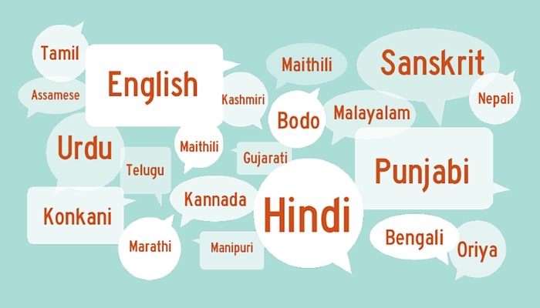

Why Do We Need Translator?
Both the person and to whom the information is delivered to will be benefited from the incorporation of translator.
People will not feel uncomfortable or hesitant since now there is no need of speaking in a foreign language.
They can freely express or convey required information in their native language.
The person receiving the information might know many languages but not english. Hence the english translator will make the information understandable for the receiver.
Not only we will be able to reach more people, it will be easier to connect with them on a more effective level, through the power of translation.

Slide 9
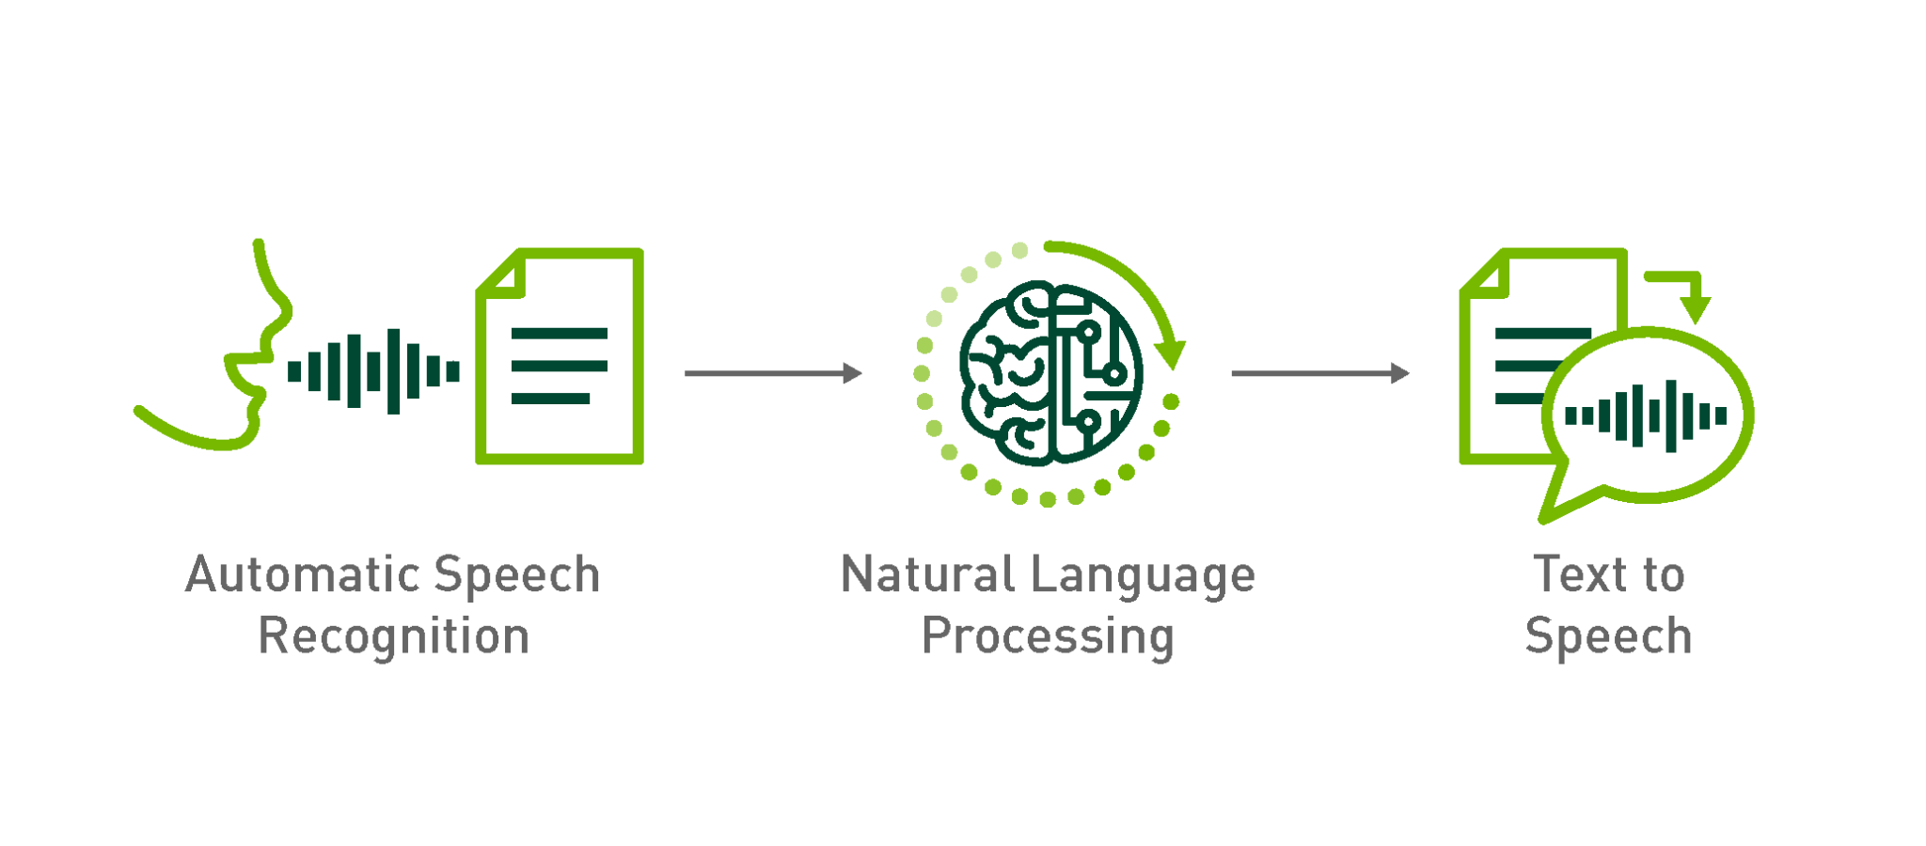
Natural Language Processing (NLP)

Slide 10
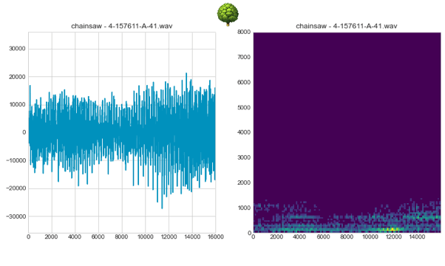
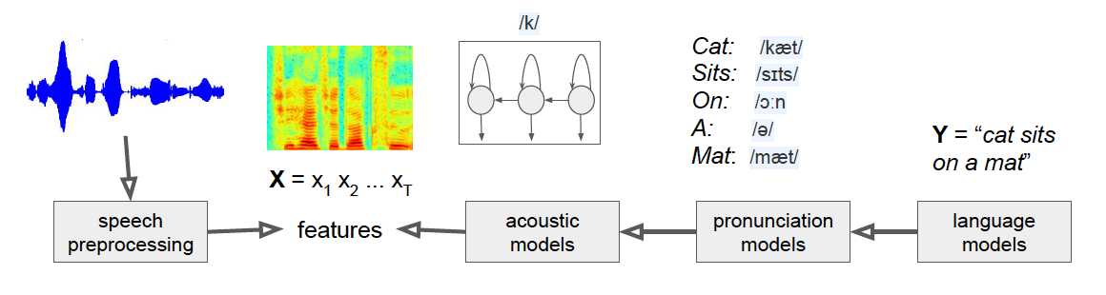
Speech Recognition
Google Speech API to convert speech to text.
It uses PLP features, Viterbi search, Deep Neural Networks, Discriminative training, WFST framework.

Slide 11
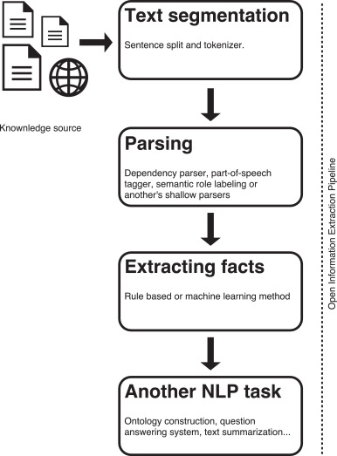
Information Extraction
Information Extraction is the process of parsing through unstructured data and extracting essential information into more editable and structured data formats.
Text mining that requires some grammar-based rules and statistical modelling approaches is usually carried using NER (Named Enitity Recognition) Algorithms. An entity extracted from NER can be the name of a person, place, organization, or product. The locationtagger library is a byproduct of further tagging and filtering places from all the other entities present.

Slide 12
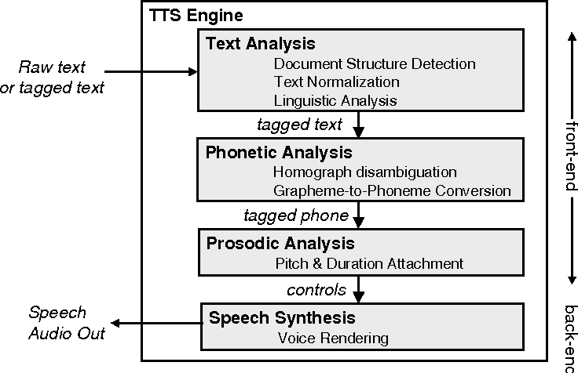
Text to Speech
Google Text to Speech API to convert speech to text.

Slide 13

Database
When the app user (restaurants) sign up in the app, their location is stored in our database.
For storing the data we use mongoDB
is very flexible and adaptable to real business world situations and requirements.
as the data is dynamic
offers faster query processing but with an increased load and system requirements.

Slide 14
Necessary Data
Data transfer (of Restaurant):
Rapid:
The quantity of food available (in-servings)
The time that it gets closed
Static:
Name of the Restaurant
Food Licence Number
Location i.e. Latitude and Longitude of restaurant.
Data transfer(of the person):
We receive the following data in text form:
Name of the person
Address
Number of serving that is required.

Slide 15
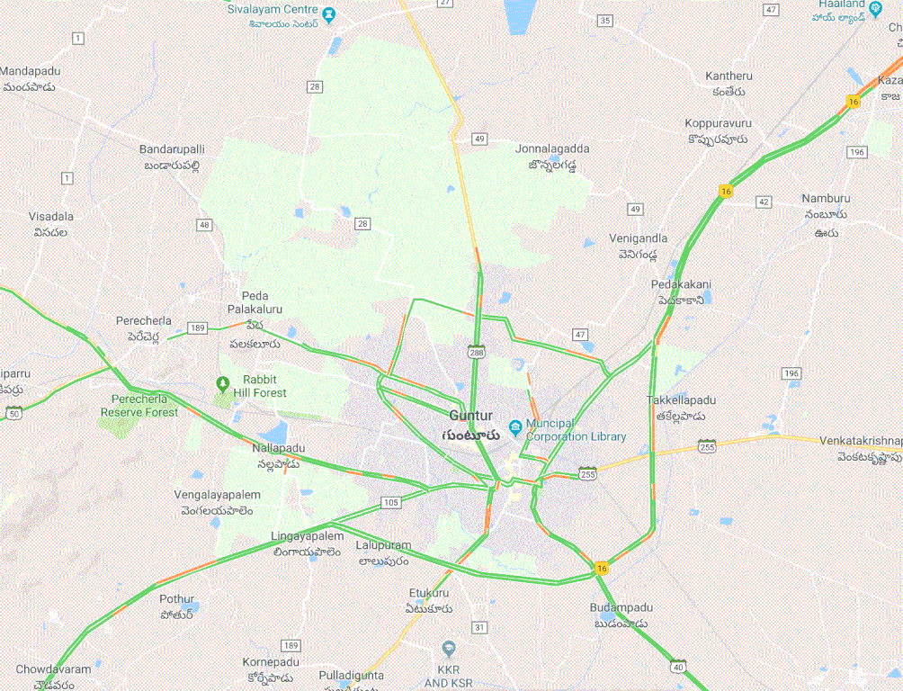
Basic & Concrete Idea
Step 1: To convert the current location of the person (which is in text) to longitude and latitudes.
Step 2: Then we map the person’s coordinates with that restaurant which:
has that many numbers of servings available
is still open
is the nearest of all available restaurants
Integration with Geocoding API

Slide 16
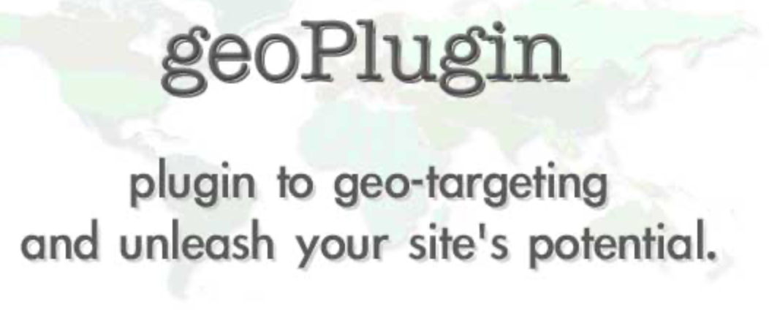
Shortest Path
First, Geocoding is the process of converting addresses into geographic coordinates (like latitude and longitude), which we can use to place markers on a map, or position the map.
This will be used to convert the location (which is in text) of the person to longitudes and latitudes. MongoDB supports geospatial queries. So, the given coordinates will be stored as geoJSON objects.
Then we use algorithms like Dijkstra’s algorithm to find the shortest distance between the user’s coordinates and restaurants coordinates and select the one which is nearest. It is basically weighted graph with nodes as the location of restaurants which have required number of servings available and are open and the person’s location and weights are the distances between them.

Slide 17
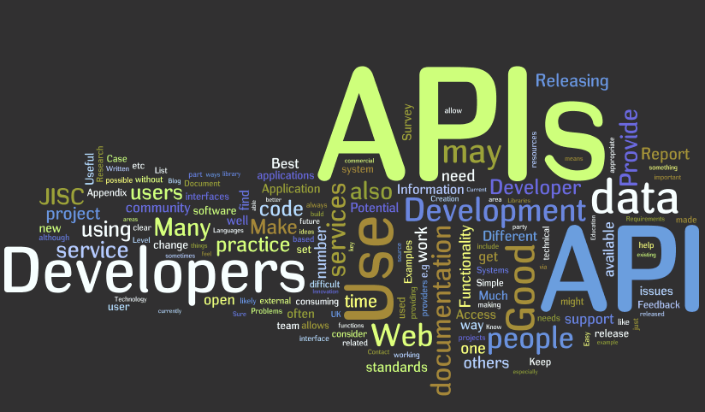
Application Protocol Interface
An application programming interface (API) is a connection between computers or between computer programs. It is a type of software interface, offering a service to other pieces of software, An application programming interface connects computers or pieces of software to each other. It is not intended to be used directly by a person (the end user) other than a computer programmer who is incorporating it into software.

Slide 18
How an API works?
Why do we need API’s
A client application initiates an API call to retrieve information—also known as a request. This request is processed from an application to the web server via the API’s Uniform Resource Identifier (URI) and includes a request verb, headers, and sometimes, a request body.
After receiving a valid request, the API makes a call to the external program or web server.
The server sends a response to the API with the requested information.
The API transfers the data to the initial requesting application.
Improved collaboration - APIs enable integration so that these platforms and apps can seamlessly communicate with one another.
Easier innovation - APIs offer flexibility, allowing companies to make connections with new business partners, offer new services to their existing market, and, ultimately, access new markets that can generate massive returns and drive digital transformation.
Added security - APIs create an added layer of protection between your data and a server.

Slide 19
Common API examples
Types of APIs
Universal logins -A popular API example is the function that enables people to log in to websites by using their Facebook, Twitter, or Google profile login details.
Third-party payment processing - This allows people to pay for products online without exposing any sensitive data or granting access to unauthorized individuals.
Google Maps - One of the most common examples of a good API is the Google Maps service.
Open APIs - open source application programming interfaces you can access with the HTTP protocol.
Partner APIs - application programming interfaces exposed to or by strategic business partners.
Internal APIs - application programming interfaces that remain hidden from external users.
Composite APIs - combine multiple data or service APIs.

Slide 20
So why do we need APIs in this project?
APIs are useful as:
The data is changing quickly:
It doesn’t really make sense to regenerate a dataset and download it every minute — this will take a lot of bandwidth, and be pretty slow. Another example can be stock price data.
We want a small piece of a much larger set of data:
If we want only chunk of a big dataset searching the whole data will only waste time and productivity. Another example can be Reddit comments. What if we want to just pull our own comments on Reddit? It doesn’t make much sense to download the entire Reddit database, then filter just our own comments.
There is repeated computation involved:
As we need to do the same task again and again with different parameters. Another example can be Spotify. Spotify has an API that can tell the genre of a piece of music.

Slide 21
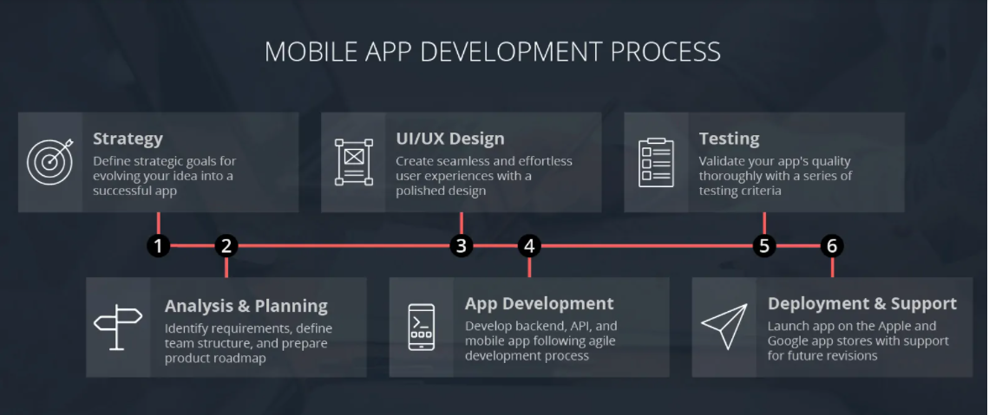
Mobile Application Development

Slide 22
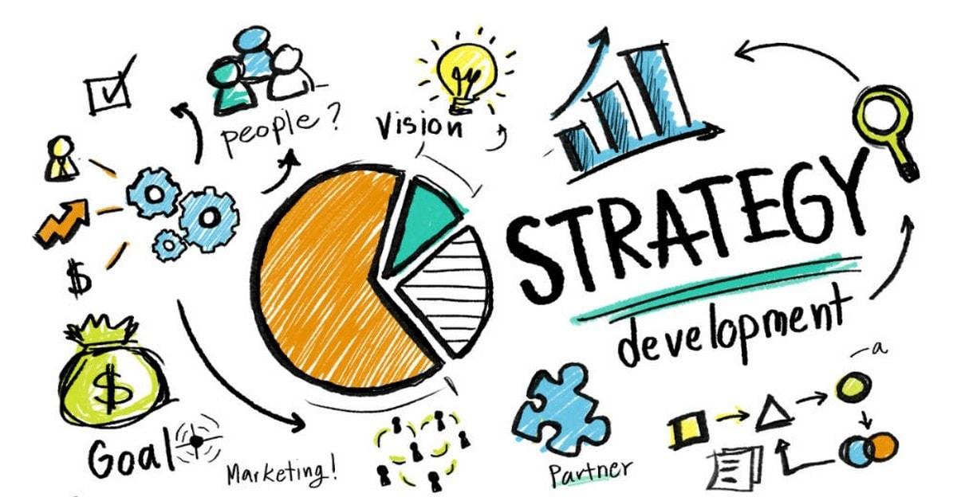

Slide 23


Users - Restaurant owners/ event planners
Goal - Connect the providers having excess foodstuffs with the consumers.

Slide 24
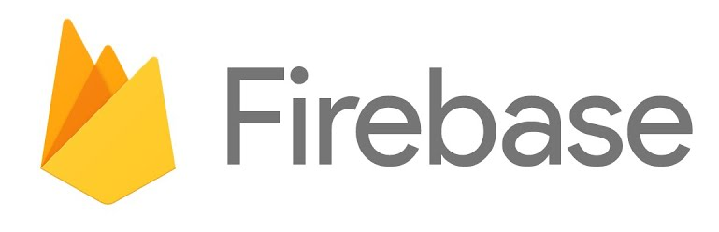

Mobile Platform
What is Firebase? Firebase is a cloud service designed to power real-time, collaborative applications. Simply add the Firebase library to your application to gain access to a shared data structure; any changes you make to that data are automatically synchronized with the Firebase cloud and with other clients within milliseconds.The Firebase Realtime Database is a cloud-hosted NoSQL database that lets you store and sync data between your users in realtime.
What is Android Studio? Android Studio is the official integrated development environment for Google's Android operating system. The Android Studio IDE is free to download and use. It has a rich UI development environment with templates.

Slide 25
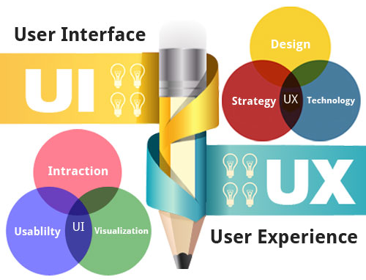

Slide 26

Data Collected
Static data
Name
Address
Pincode
Contact number
Email address
Opening/closing timings
Unique identification number - GSTIN number
Dynamic data
Approx excess food available at a specific location
Amount
Veg/Non-veg
Last updated time

Slide 27

Data Displayed
Number of consumers available in vicinity
Number of bookings done
Pickup status
Excess food utilization status
Number of people who reached out on a daily, weekly, monthly and yearly basis

Slide 28

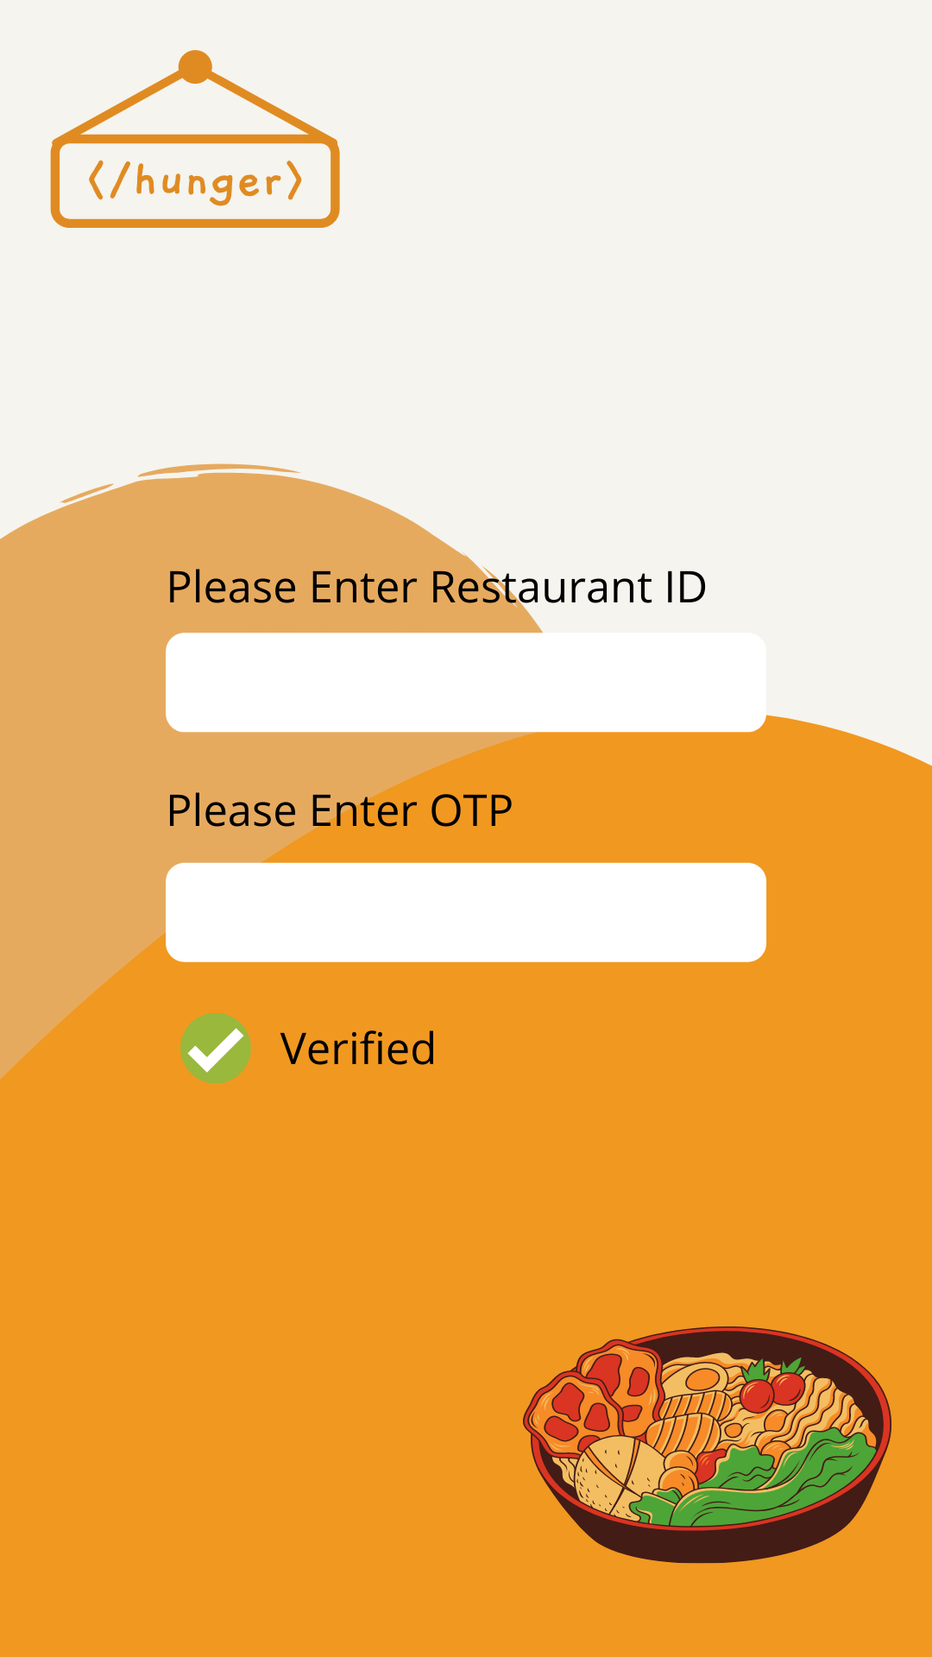

Slide 29
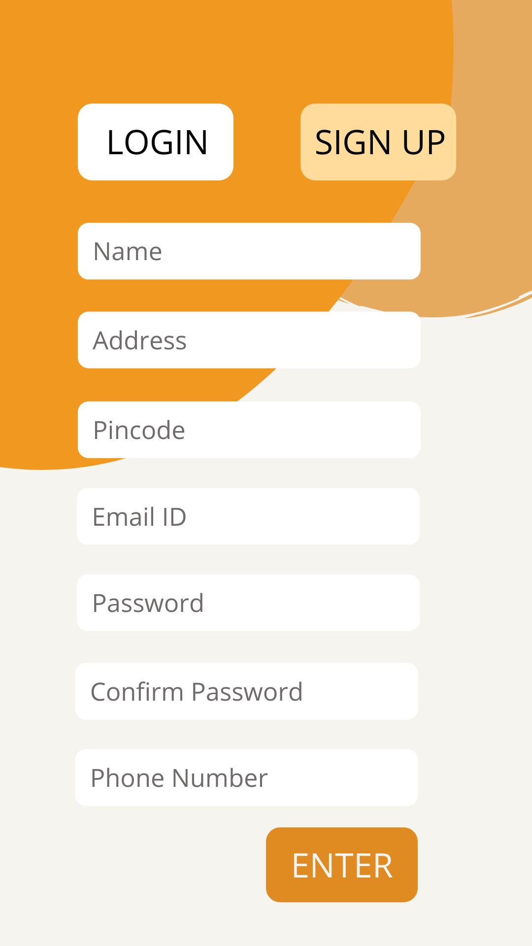
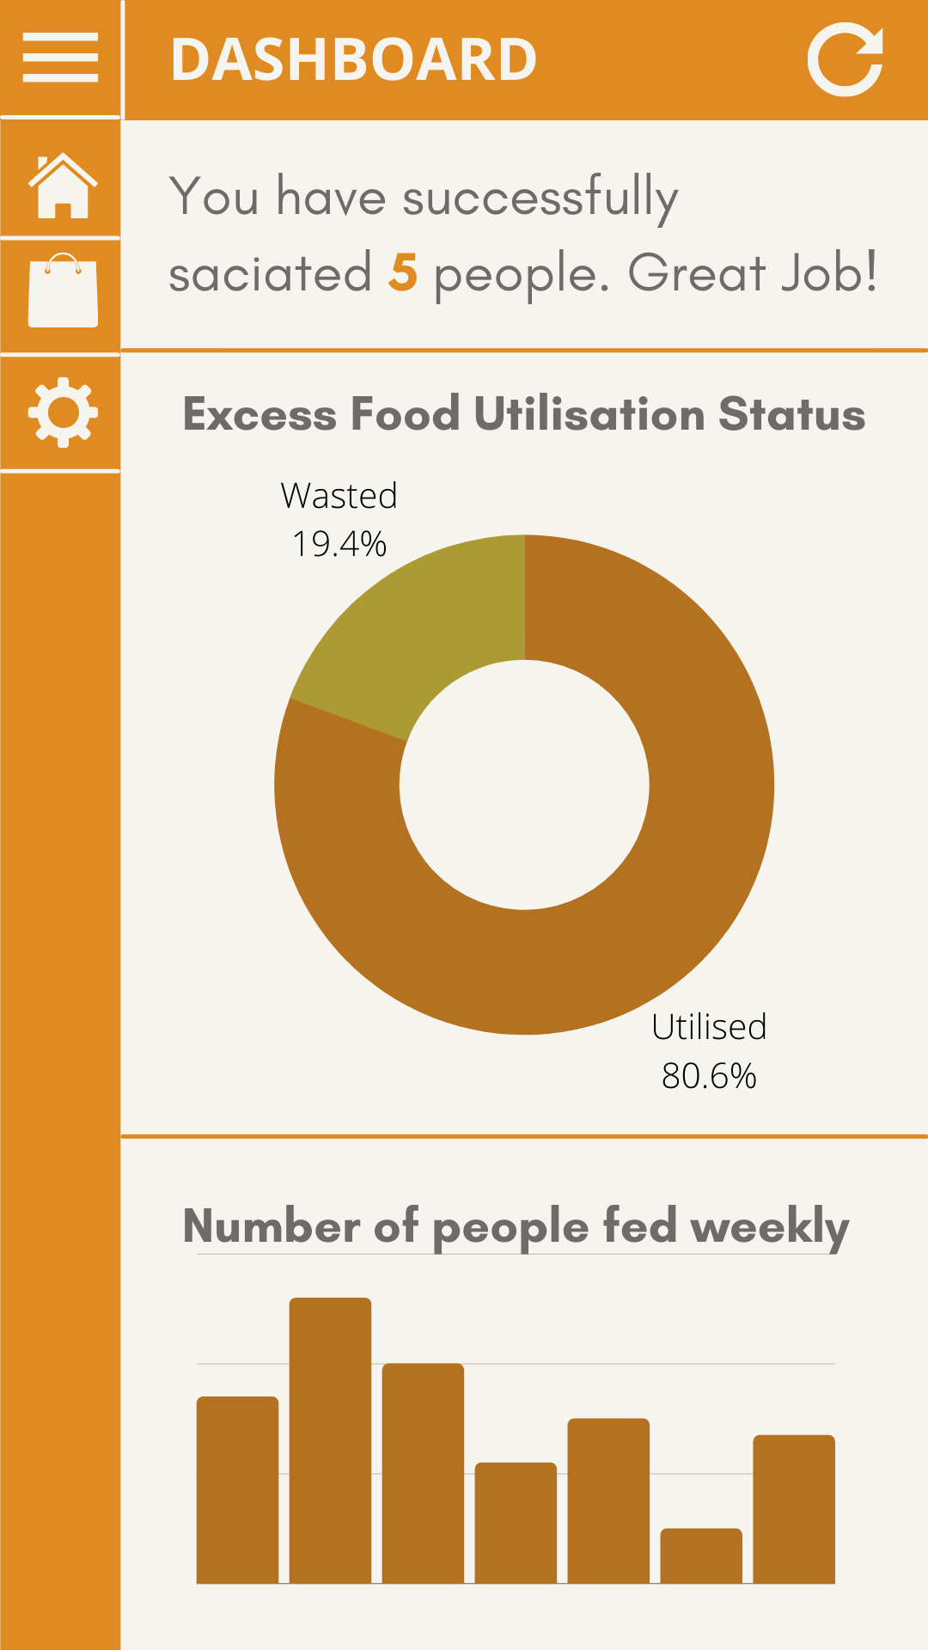

Slide 30
References
https://www.ibm.com/cloud/learn/api
https://en.wikipedia.org/wiki/API
https://www.geeksforgeeks.org/extracting-locations-from-text-using-python/
https://hindrise.org/hunger-ngo-in-india#:~:text=Facts%20Concerning%20Hunger%20in%20India&text=Over%2020%20crore%20Indians%20go,falls%20beneath%20the%20underfed%20category.
https://www.avristech.com/food-waste-management-in-india/
https://developers.google.com/maps/documentation/javascript/geocoding
https://www.thepythoncode.com/article/translate-text-in-python
https://www.invonto.com/insights/mobile-app-development-process/

Slide 31


Slide 32
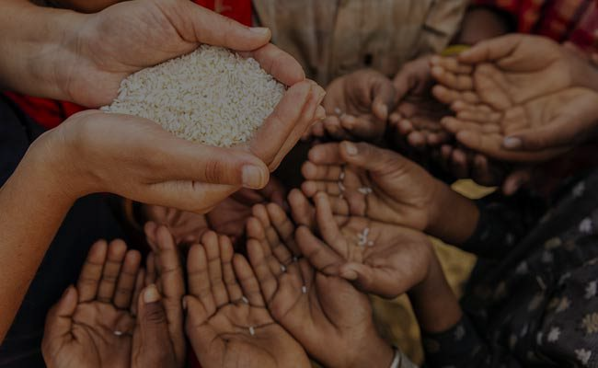
#PHASE - II - REVIEW - 2
</HUNGER>
An initiative project to end the starvation.

Slide 33
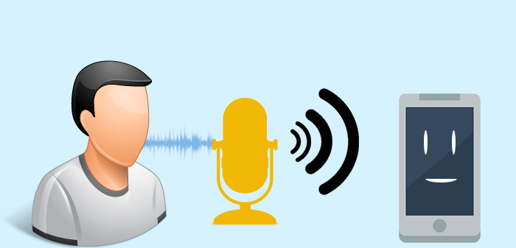
SIP and Python Speech Recognition
Few things to know before:
Asterisk
Softphone

Slide 34
What is Asterisk?
Asterisk-python is a simple python library that allows to interact with various Asterisk APIs. It’s a free and open source framework for building communications applications
What is SIP?
SIP, or Session Initiation Protocol, is a protocol that can be used to set up and take down VoIP or Voice over Internet Protocol, which is a family of technologies that enables voice to be sent over the Internet.
What is Softphone?
A softphone is a software program for making telephone calls over Internet using a general purpose computer rather than dedicated hardware. It can be installed on desktop, mobile device, or other computer and allows user to place and receive calls without requiring an actual telephone set.

Slide 35
Pyttsx3 Library- pyttsx3 is a text-to-speech conversion library in Python. Unlike alternative libraries, it works offline and is compatible with both Python 2 and 3.
Speech Recognition- For performing Speech Recognition, there is SpeechRecognition library which is open source and several engines and APIs provide in both modes online and offline mode.
NLTK- The Natural Language Toolkit(NLTK), is a suite of libraries and programs for symbolic and statistical natural language processing (NLP) for English written in the Python programming language. It provides a practical introduction to programming for language processing.
spaCy- It’s a free and open-source library for Natural Language Processing (NLP) in Python with a lot of in-built capabilities. It’s used for processing and analyzing data in NLP.
Maxent_ne_chunker- The maxent_ne_chunker contains two pre-trained English named entity chunkers. It is used by the nltk.ne_chunk() function.

Slide 36
Treebank- It’s a collection of syntactically annotated sentences in which the annotation is checked so that it can serve as a training corpus for natural language parsers, as a repository for linguistic research, or as an evaluation corpus for NLP systems.
maxent_treebank_pos_tagger-NLTK is a fantastic library to support NLP. It provides a number of tagging models. The default tagging model is the maxent_treebank_pos_tagger.
Punkt-This tokenizer divides a text into a list of sentences, by using an unsupervised algorithm to build a model for abbreviation words, collocations, and words that start sentences.
averaged_perceptron_tagger- The perceptron part-of-speech tagger implements part-of-speech tagging using the averaged, structured perceptron algorithm.
Location Tagger-Return the entity with location information.

Slide 37
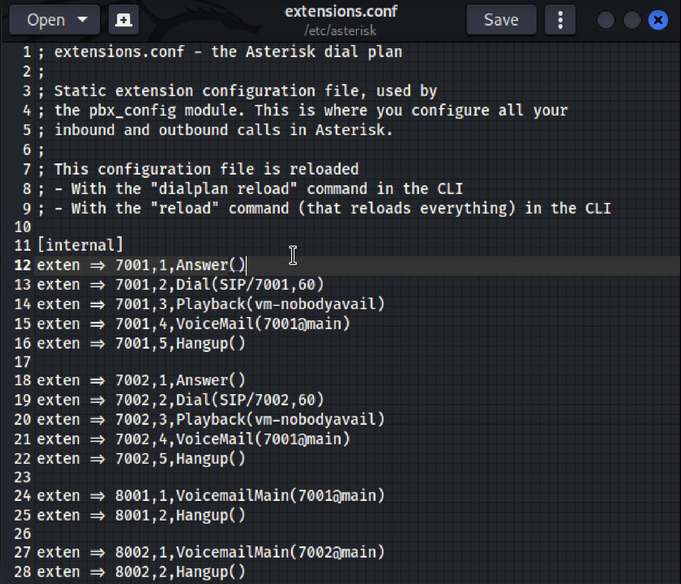
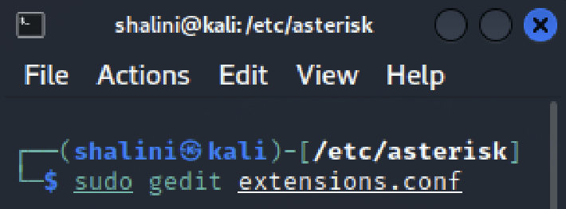
Setting up SIP
Step 1 : Editing extensions.conf

Slide 38
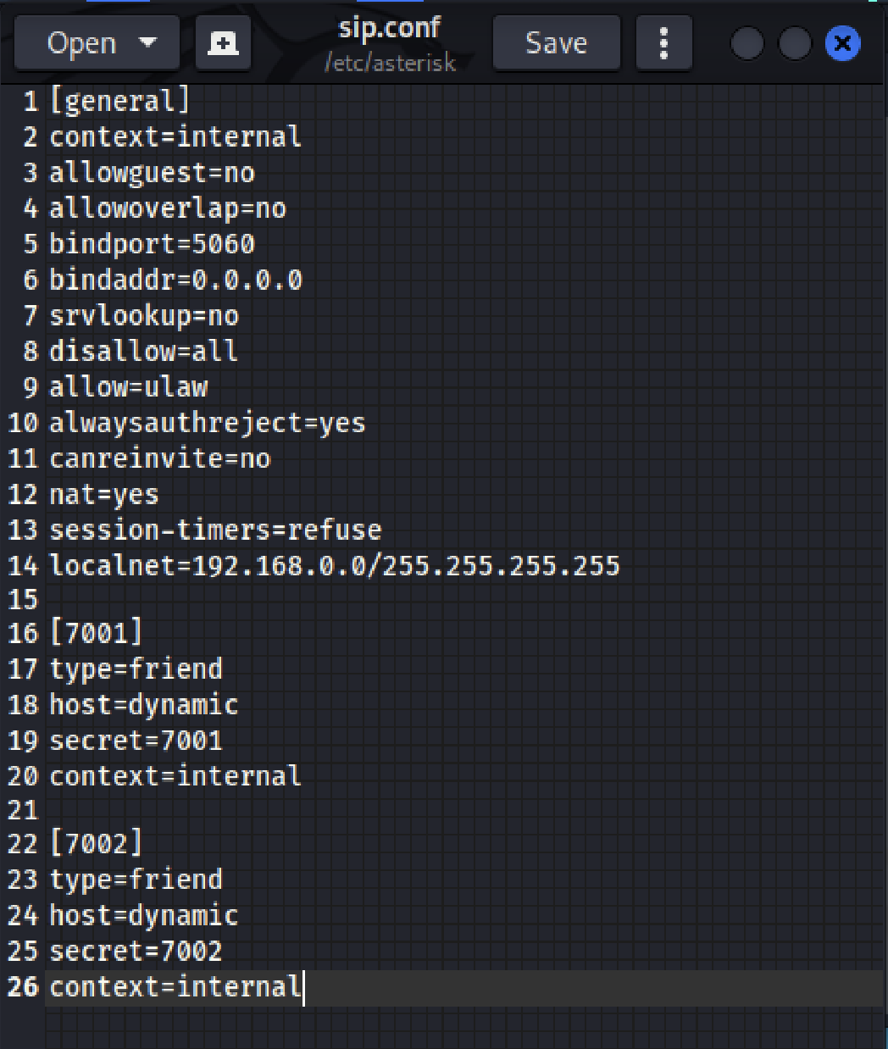
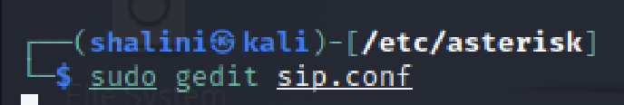
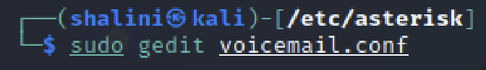
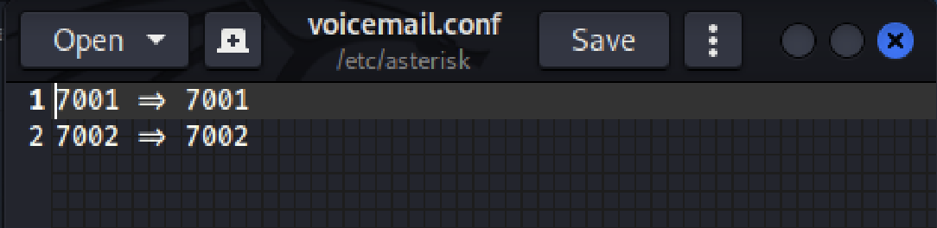
Step 2 : Editing sip.conf
Step 3 : Editing voicemail.conf

Slide 39
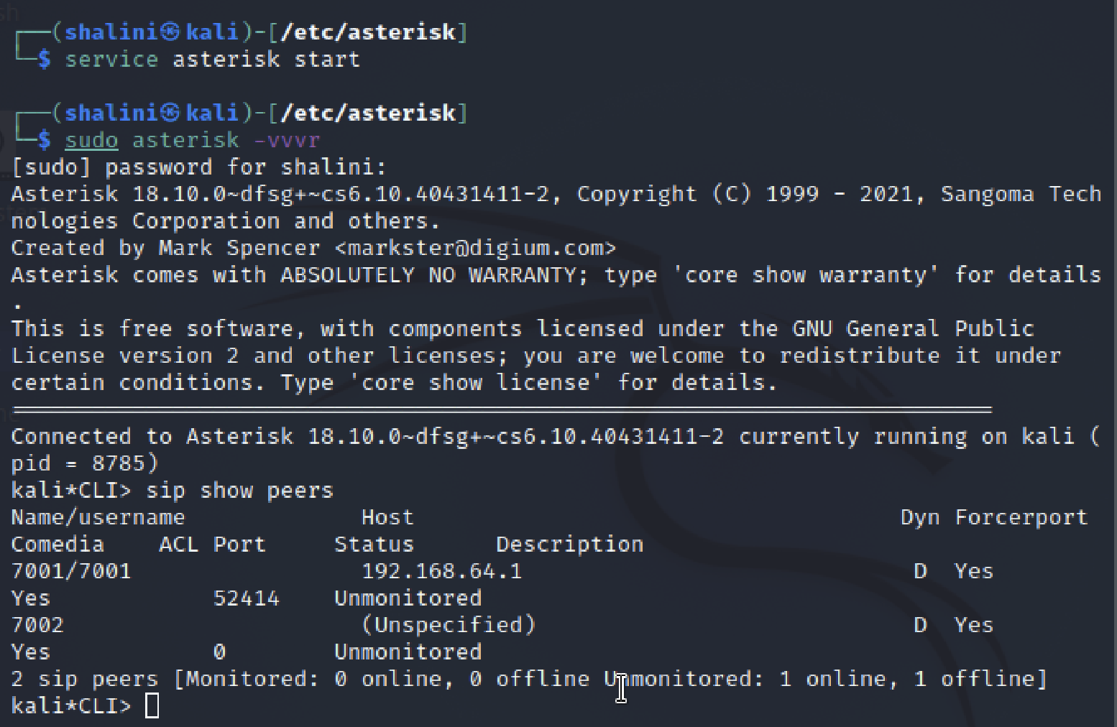
Step 4 : Starting asterisk server

Slide 40
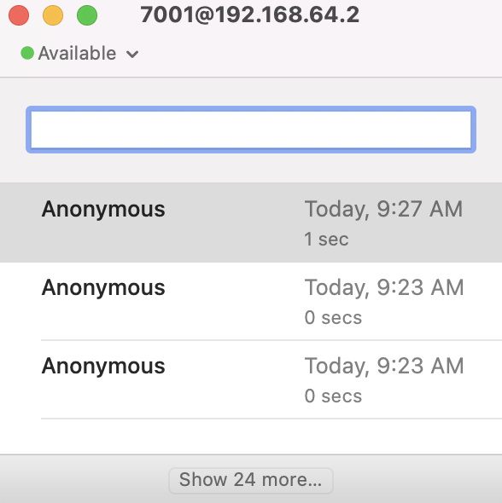
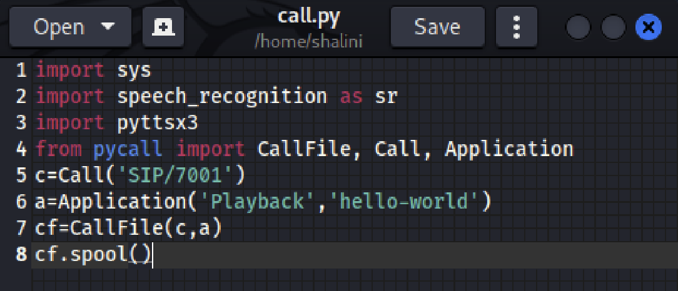
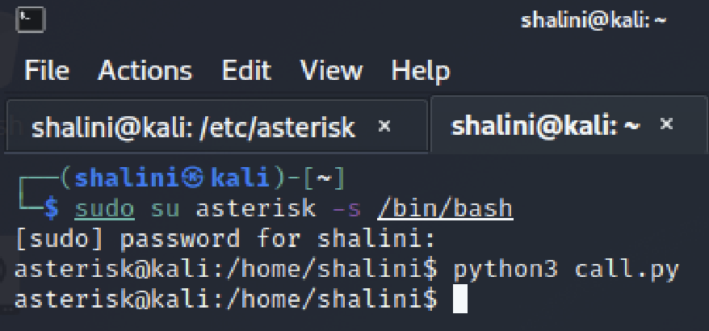
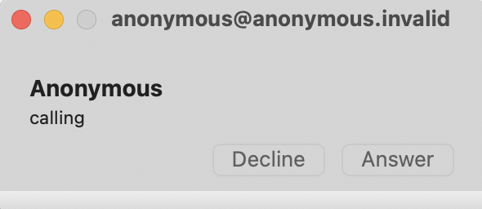
Step 5 : Integrating python file with asterisk and run it

Slide 41
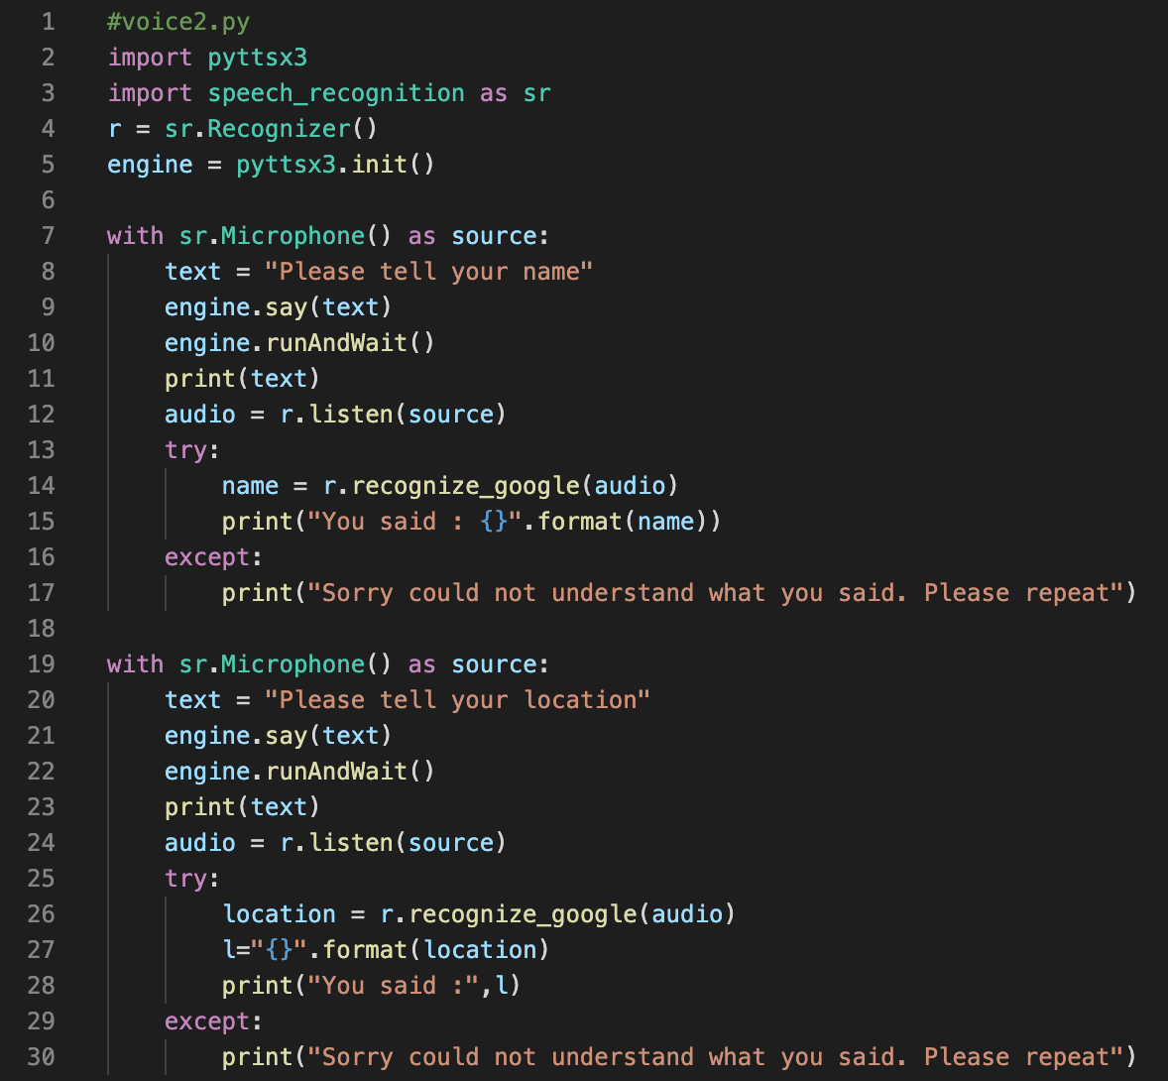
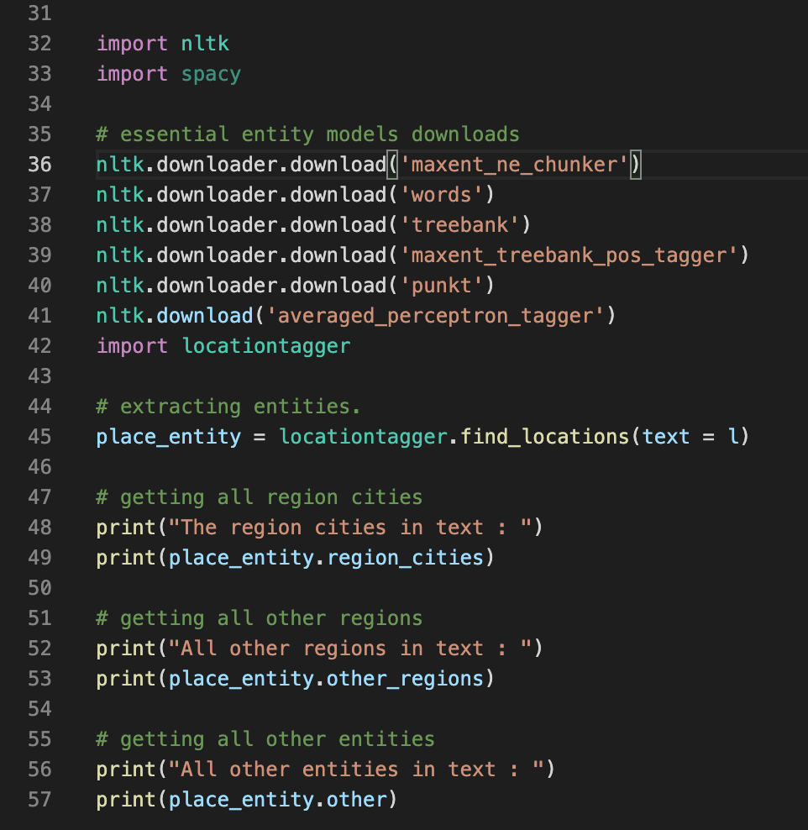
Python Speech Recognition and location tagging

Slide 42
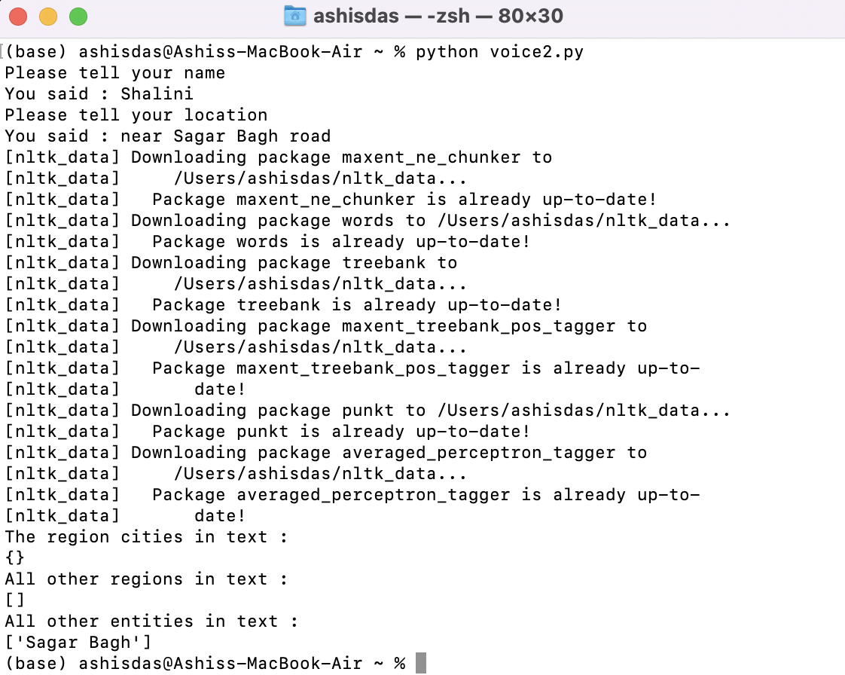
Output:

Slide 43
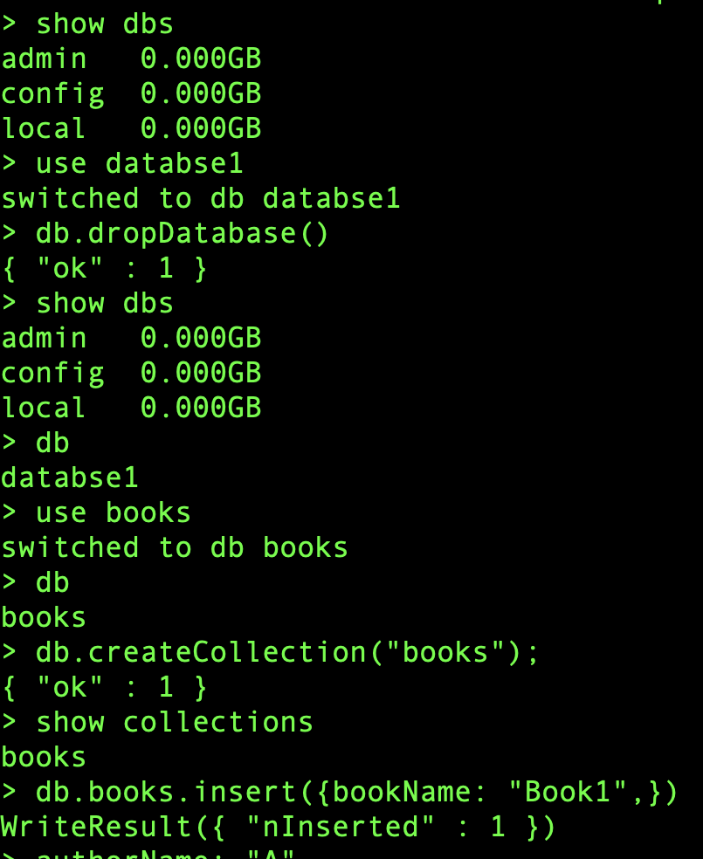
Database:
As we will be using MongoDB more frequently, here are some basic/common operations that are used:
show dbs: to know about about the present databases.
use database_name: to create a new database
db.createCollection(“collection_name”): to create a new collection.
use collection_name: to use the collection
db.collection_name.insert(): to insert one attribute and value.

Slide 44
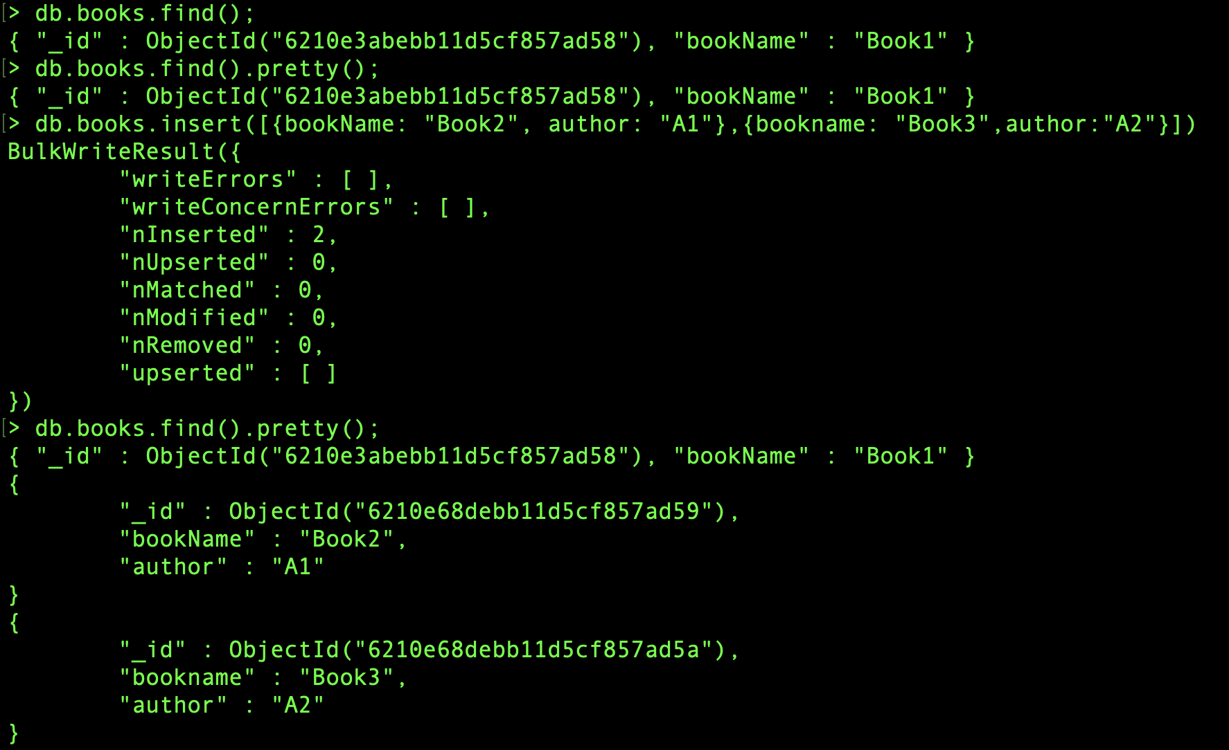
db.collection_name.find(): to display the complete status of the database. We can even find a particular key-value pair by passing suitable condition in the argument.
db.collection_name.update(): can be used to correct/add a new attribute to a particular object. And if the attribute is not already present, we can add that by using “upsert” keyword.

Slide 45
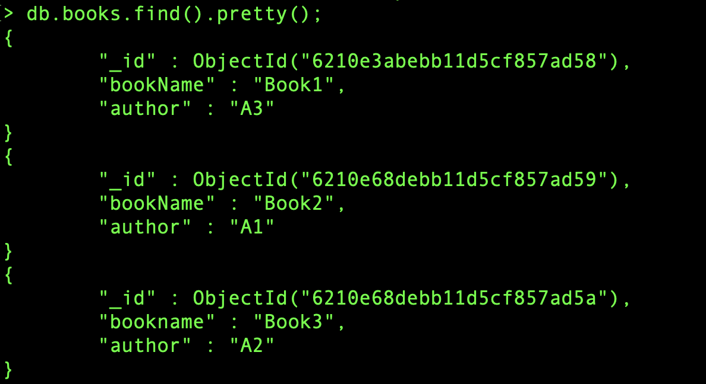

Slide 46
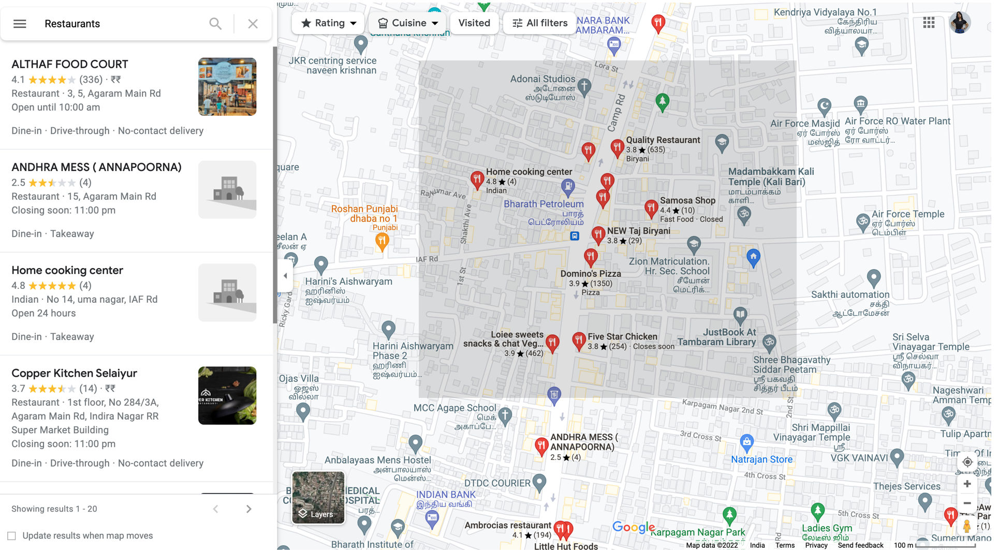
Geospatial Queries:

Slide 47
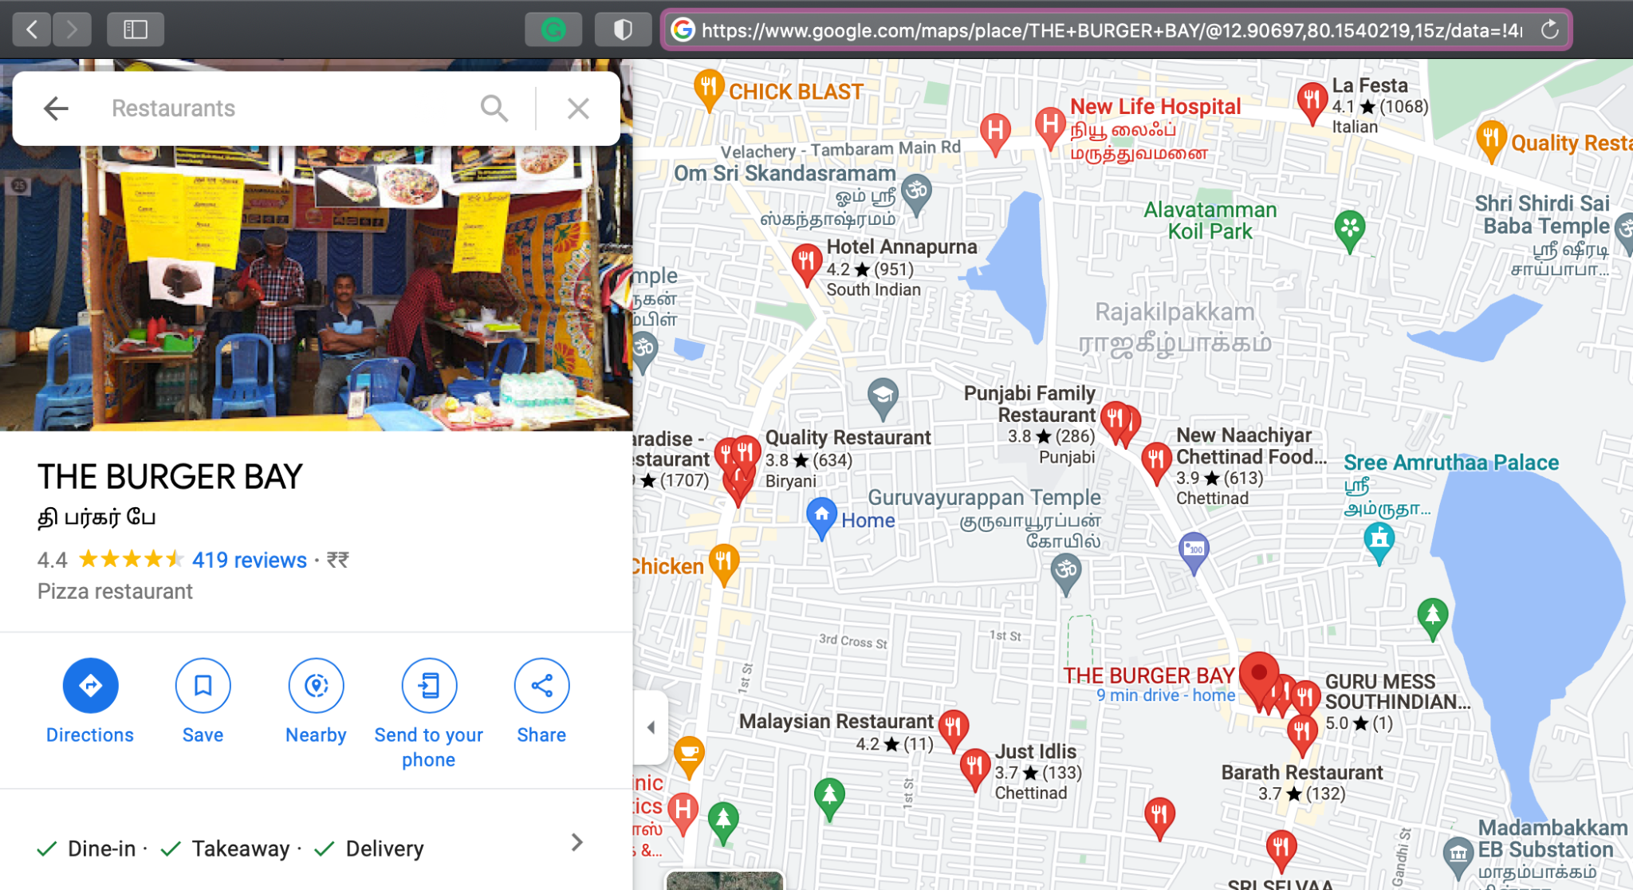

Slide 48
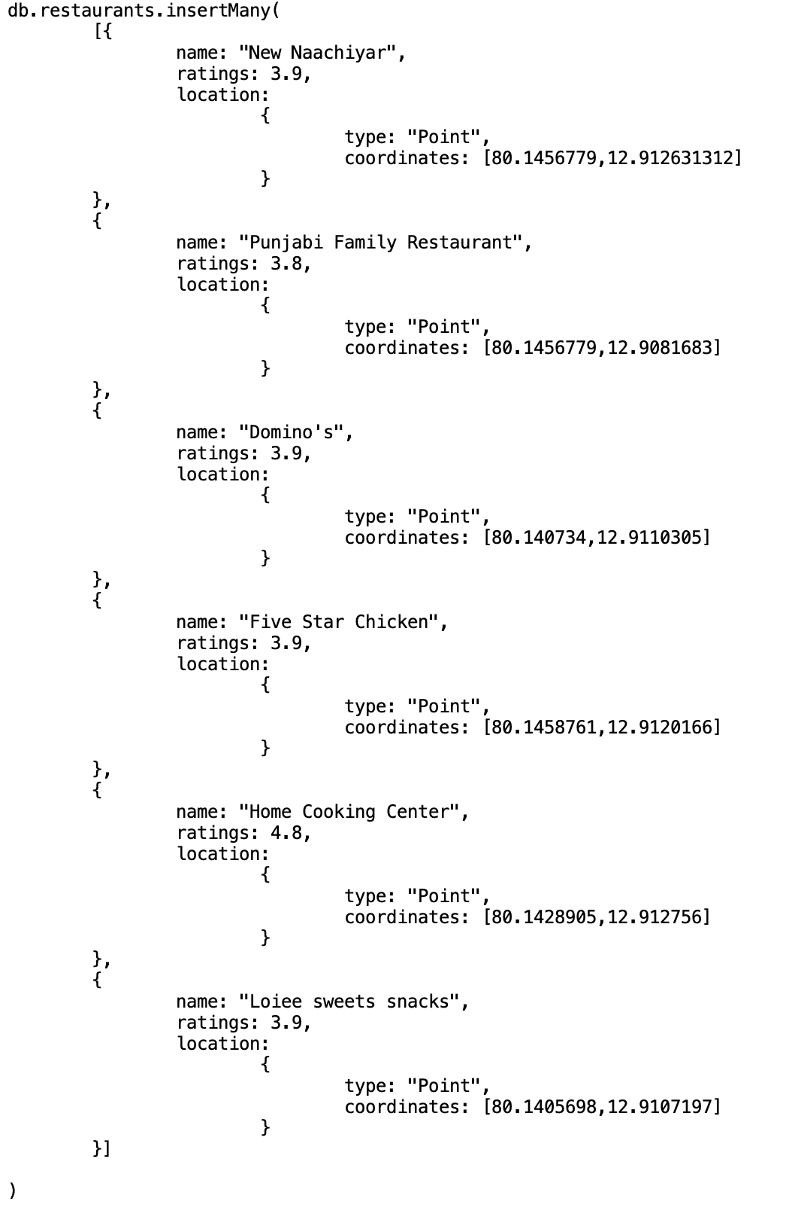
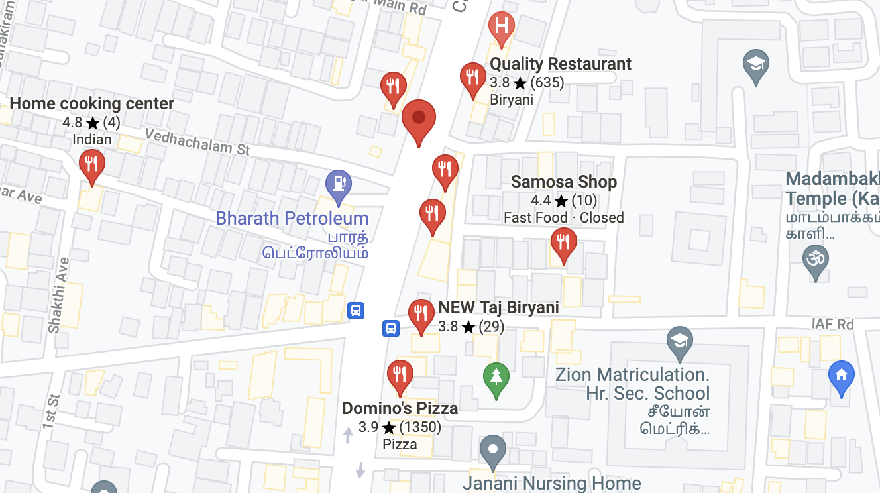
Latitude: 12.913399,
Longitude: 80.143457

Slide 49
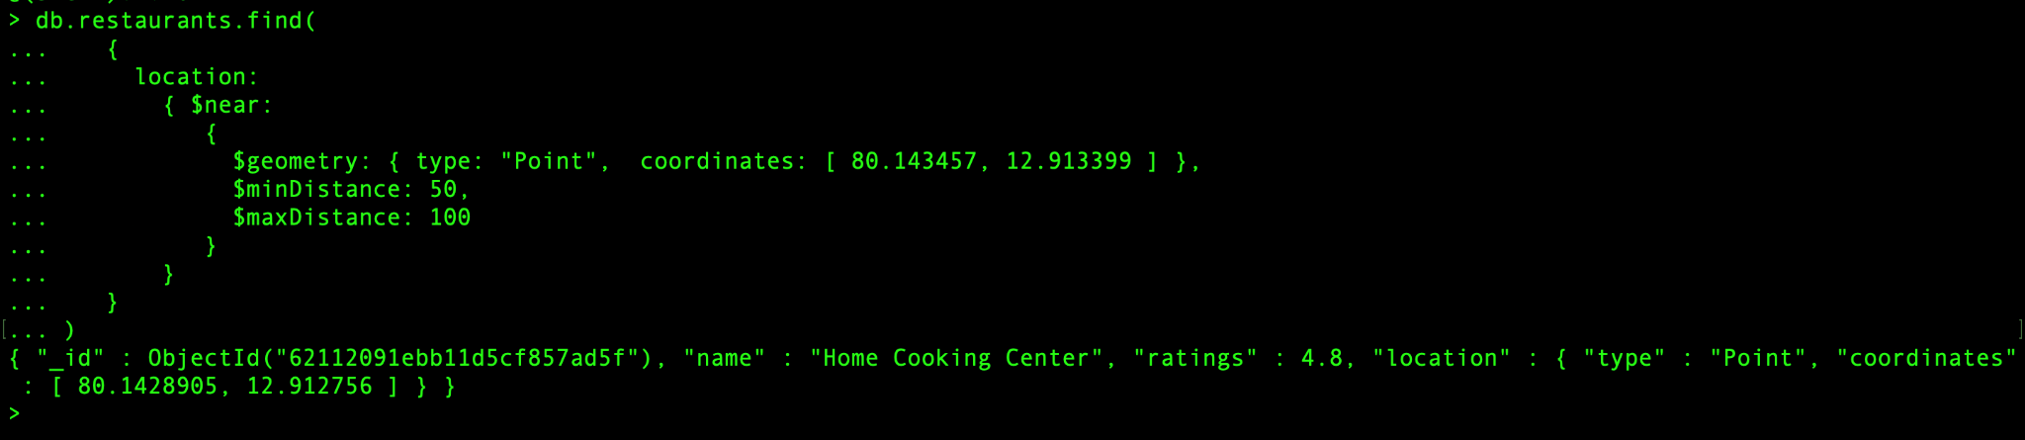
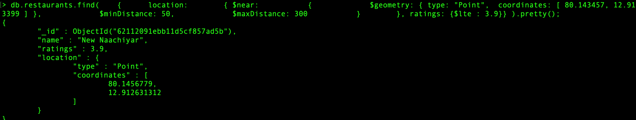

Slide 50
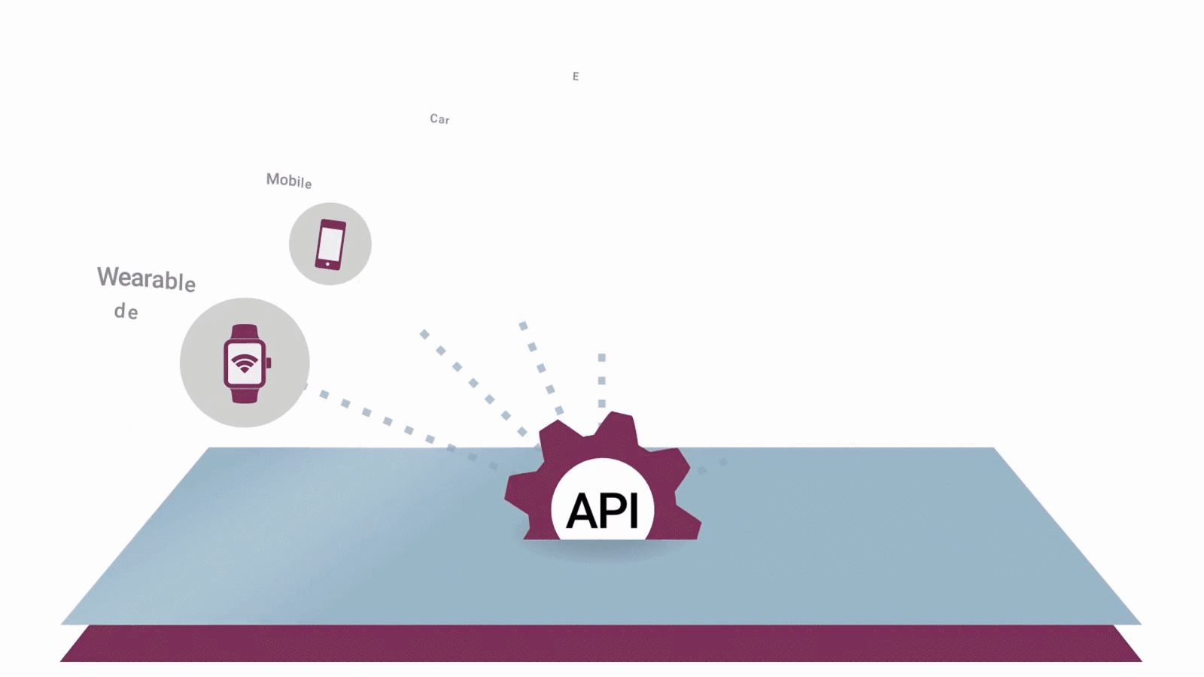
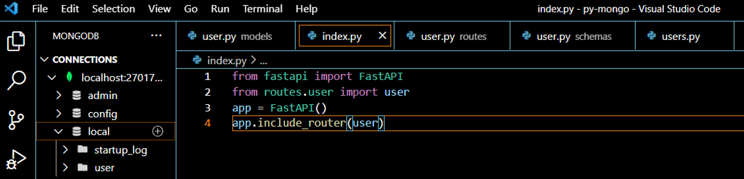
Implementation of the Connections: The API
Step1: Importing the necessary modules and initiation of the function:
Here we are using FastAPI as it is a modern, python-based high-performance web framework used to create Rest APIs. Its key features are that is fast, up to 300% faster to code, fewer bugs, easy to use, and production-friendly.
For installation we used:
pip install fastapi : Installation of the FASTAPI Library
pip install uvicorn : Installation of an ASGI server, for production.

Slide 51
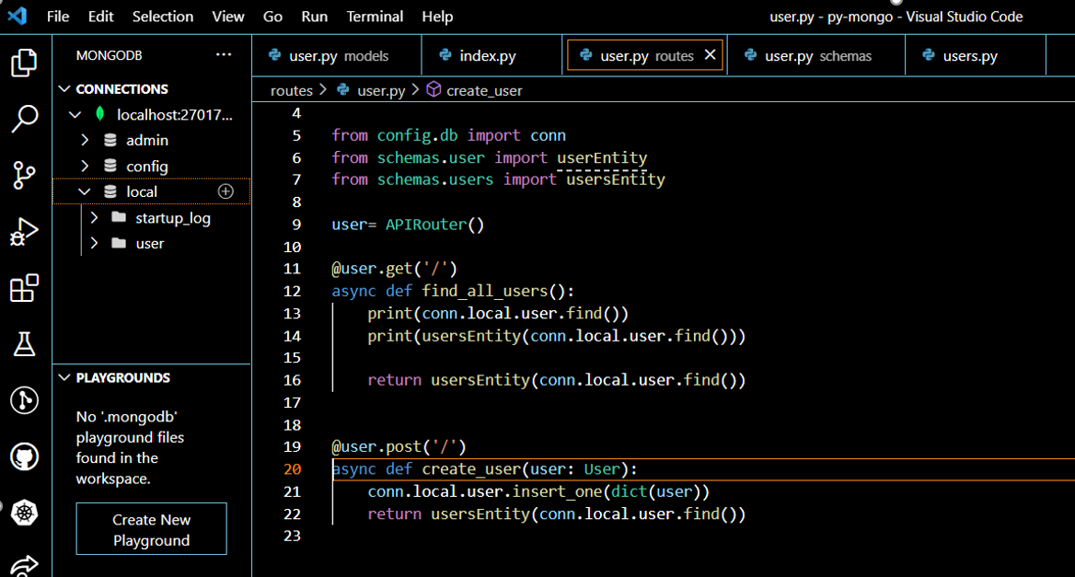
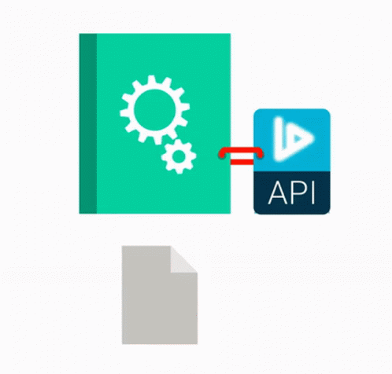
Step 2: Making the Connection:
Here we import the necessary libraries and modules for the connection of API to the MongoDB database. Then we define a user variable with the inbuilt function APIRouter function call. Also we define 2 methods, the get and the post methods which which will be used to retrieve and enter user data respectively.

Slide 52



Step 3: Defining the Base-Model:
Here we define the base model for the user. Firstly we import the BaseModel module from the pydantic library and then we define base-model as a name of person in type string, his/her email address and password all type string.

Slide 53




Step 4: Defining the user-entity and iterating through each:
Now we define the schema or the structure for the database in the MongoDB. The “id” field is by default given by Mongo to every document of the collection and we convert this item to string. We already have defined the storage type of each of other items in user model.
Lastly we iterate through every item in the user entity and return it to the database.

Slide 54


Step 5: Analysis of the connection through output:
We insert the data using the POST Button.
We get the following response from the FASTAPI, the server and and the database in the MongoDB compass application.

Slide 55




(1)
(2)
(3)

Slide 56




Hunger
An android based application

Slide 57


Screen#1

Slide 58


Screen#2

Slide 59


Slide 60



Screen#3

Slide 61


Slide 62

Dashboard Design and
XML Explanation

Slide 63
Dashboard Design

Slide 64


Slide 65

XML Explanation of Dashboard

Slide 66


Slide 67


Slide 68


Slide 69
Registration No. | Name | Individual Contribution | Presentation Slides
19BAI10008 | Pranjal Roy | Implementation of Geospatial queries. | 46 - 49
19BAI10017 | Shanzeh Batool | Android application development of first 3 screens & integration with Firebase database. | 56 - 61
19BAI10081 | Vaibhav Roy | Basic commands on Mongodb and explanation. | 43 - 45
19BAI10095 | Karan Jain | Self Learning on Project modules (API). PPT creation (API). | 32, 53 - 55
19BAI10139 | Shalini Das | Implementation of asterisk, python speech recognition, text to speech conversion and information extraction on text.. | 37-42
19BCE10108 | Ashi Sachan | Android Application development. Dashboard development of the android app. XML Code for the dashboard. | 62-68
19BCY10044 | Krishna Kumar Agrawal | Self Learning and software implementation on Project modules (API). | 50 - 52
19BEE10020 | Rituparna Gupta | Searching and learning of the tools and techniques that can help in speech recognition from phone call | 34-36

Slide 70
References
https://fastapi.tiangolo.com/
https://realpython.com/fastapi-python-web-apis/
https://www.youtube.com/watch?v=GN6ICac3OXY
https://en.wikipedia.org/wiki/FastAPI
https://developer.android.com/studio/intro
https://firebase.google.com/docs/android/setup
https://www.asterisk.org/
https://buildmedia.readthedocs.org/media/pdf/pycall/latest/pycall.pdf
https://www.youtube.com/watch?v=F7P2Y8wjVdI&t=301s
https://docs.mongodb.com/manual/geospatial-queries/

Slide 71


Slide 72


#PHASE - II - REVIEW - 2
</HUNGER>
An initiative project to end the starvation.

Slide 73
DSN3099 - Engineering Projects in Community Service
</HUNGER>
TEAM - 4
Group Members:
19BAI10008 PRANJAL ROY
19BAI10017 SHANZEH BATOOL
19BAI10081 VAIBHAV ROY
19BAI10095 KARAN JAIN
19BAI10139 SHALINI DAS
19BCE10108 ASHI SACHAN
19BCY10044 KRISHNA KUMAR AGRAWAL
19BEE10020 RITUPARNA GUPTA
Project Supervisor:
Dr. Preetam Suman – SCSE - 100359

Slide 74



OBJECTIVE
AIM : END HUNGER
“Hunger has no friend but its feeder”
STUNTED GROWTH
BEHAVIOURAL ISSUES
MALNUTRITION
CHILD MORTALITY

Slide 75


Slide 76

EXISTING PROJECTS

Slide 77

SIMILARITIES
Connect food donours with food rescue groups
Fight food wastage
Saved over 22,000 tonnes of food from landfills
DIFFERENCES
Involvement with food rescue groups and local community kitchens

Slide 78

SIMILARITIES
Manage the untouched surplus food
DIFFERENCES
Redistributing food via connecting with social institutions, events & volunteer food recovery
Food delivery based system

Slide 79
PROJECT MODULES
The NLP interactive model:
The platform and interface with which the hungry person conversates.
The Interactive Voice Response System (IVRS) architecture and its usage.
Inside the database.
The structure of the data stored in the database.
The working of geospatial queries.
Android application framework.
The user interface used to transmit information to and from hotels.
The architecture of the android application.

Slide 80
Module 1 : The NLP interactive model
Pre-requisites:
Pymongo- Python distribution containing tools for working with MongoDB,
Requests- Allows to send HTTP requests using Python, which returns a Response Object.
Urllib.parse- It defines standard interface to break URL strings in components.
Bson.son- A subclass to maintains ordering of keys and provide necessities for SON.
MongoClient- Used to connect to the MongoDB database efficiently and effortlessly.
Geosphere- To create a spherical (earth-like) geospatial index.
Geopy- Used to locate the coordinates of addresses, cities, countries, and landmarks.
Gecoders- Used for resolving location from a string.
Nominatim- Tool to search OpenStreetMap data by address or location (geocoding).

Slide 81

The IVRS - NLP model flowchart

Slide 82

Module 2: Inside the database
How is the data stored in the database?
Create a new database.
See collections of a particular database
Details of cluster
Current database
Current collection
Collection’s relative address.
Collection’s properties.
Database tools
Insert a new data to the collection.
10. Data in the form of documents.
11. Number of documents displayed at a time.

Slide 83

How the model finds a nearest restaurant/hotel with food available to donate?

Slide 84

Module 3: Android Application Framework

Slide 85

Use Case Diagram
HUNGER ANDROID APPLICATION

Slide 86

The Project’s Outcome
Notes:
Karan maine objective slide ko kuchh krdiya okk
Oh axaxa lemme see

Slide 87
RegNo. | Name | Role | Individual Contribution | Slides
19BAI10008 | Pranjal Roy | Domain Leader - DBMS | MongoDB database creation and management with data insertion and updation. Programming the geospatial queries to find the nearest food available restaurants. | 82-83
19BAI10017 | Shanzeh Batool | Domain Leader - Android App | Creation and management of the Firebase database. Programming the backend sub-domain of the Android application. | 84
19BAI10081 | Vaibhav Roy | Domain Member - DBMS | Exploring the different databases and choosing the best one that can be used in the project. Learning and executing the basic commands in the MongoDB database. | 76-78
19BAI10095 | Karan Jain | Project Leader, Domain member - Integration | Extracting the latitudes-longitudes from the addresses and vice-versa through geocoding. Commitment to ensuring the team succeeds with all tasks, duties of the project. | 72-73, 86

Slide 88
RegNo. | Name | Role | Individual Contribution | Slides
19BAI10139 | Shalini Das | Domain Leader - NLP IVRS Model | Creation and debugging of the NLP Interactive Machine Learning Model. Exploring the text-to-speech and speech-to-text methods of NLP. | 81
19BCE10108 | Ashi Sachan | Domain Member - Android App | Designing the User Interface of the Android application. Programming the frontend sub-domain of the Android application. | 85
19BCY10044 | Krishna Kumar Agrawal | Domain Leader - Integration | Programming the MongoDB database integration with Android Studio. Debugging and testing the integration of the MongoDB database and the NLP model. | 74-75
19BEE10020 | Rituparna Gupta | Domain Member - NLP IVRS Model | Raw Data preparation, cleaning and ordering of the restaurants. Exploring the different methods used for tele-calling and communication. | 79-80

Slide 89
References:
https://www.tutorialspoint.com/mongodb/mongodb_java.htm
https://code.tutsplus.com/tutorials/how-to-use-mongodb-stitch-in-android-apps--cms-31877
https://www.mongodb.com/docs/realm/sdk/java/examples/connect-to-mongodb-realm-backend-app/
https://towardsdatascience.com/pythons-geocoding-convert-a-list-of-addresses-into-a-map-f522ef513fd6
https://towardsdatascience.com/things-to-do-with-latitude-longitude-data-using-geopy-python-1d356ed1ae30
https://github.com/PhilJay/MPAndroidChart
https://www.thepythoncode.com/article/using-speech-recognition-to-convert-speech-to-text-python
https://www.geeksforgeeks.org/extracting-locations-from-text-using-python/
https://www.finedininglovers.com/article/best-food-waste-apps
https://geopy.readthedocs.io/en/stable/
https://www.educba.com/mongodb-geospatial/

Slide 90

Demonstration video link: Demo VIDEO.mp4

